Slide 1
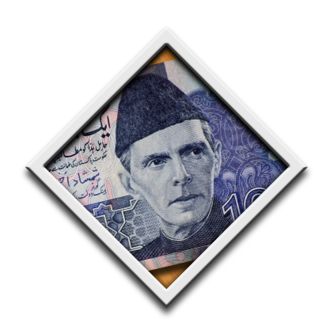
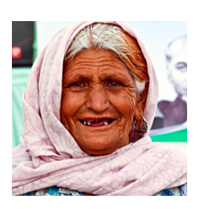
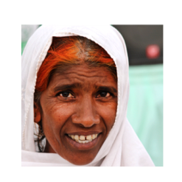
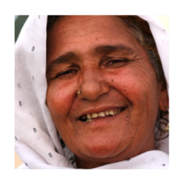
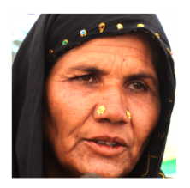
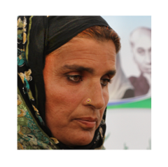
BISP
BENAZIR INCOME SUPPORT PROGRAMME

Slide 2
BISP - INTRODUCTION
BISP, a statutory body established under an Act of Parliament – BISP Act 2010
First largest, methodical & transparent social safety net
Nationwide presence: 2024 employees
Maintains National Socio-Economic Registry: Latest, scientific, reliable and extensive database of socio-economic status of the population
Technology based operations

Slide 3
ESTABLISHMENT & MANAGEMENT
BISP
Board
Chairperson
Secretary (HQ)
Regional Offices (6)
Divisional Offices (35)
(inclusive AJK & GB)
Tehsil/Sub-divisional Offices (415)
Chief Patron & Executive Patron
……………………..
……………………..
Council
HQ
……………..

Slide 4
BISP OPERATIONS
Programme Key features:
Scientific
Targeting
PMT based Poverty Scorecard Survey (Phase I & II)
Verification
Through State of the Art NADRA Database
Post Office & Branchless Banking: Smart Card/ Mobile Banking/Debit Cards
Payments
Grievance
Redressal
Web based management information system.

Slide 5
BISP INITIATIVES
Core Initiative
Unconditional Cash Transfers
Complementary Initiatives/programs
Conditional Cash Transfers (Waseela e Taleem)
Vocational & Technical Training (Waseela e Rozgar)
Micro-finance (Waseela e Haq)
Health Insurance
Life Insurance
(Waseela e Sehet)

Slide 6
Selection of Beneficiaries
Targeting

Slide 7
TARGETING PHASE-I
Targeting through Parliamentarian
8000 forms were given to each MNA/Senator
1000 forms were given to each MPA
4.2 million filled form received from parliamentarians
Screening criteria was developed
After screening by NADRA 2.24 million forms were accepted
Phase-I Targeting: Oct 2008 to April 2009
Phase –I Payments: Jan 2009 to June 2011
Almost Rs. 64.4 billion disbursed amongst Phase-I beneficiaries

Slide 8
ISSUES IN TARGETING PHASE-I
Community based targeting in Phase I – Subjective
Design inadequacies
Inclusion & exclusion errors
Limited screening criteria
Limited out reach
Decision to go for scientific targeting based on PMT

Slide 9
PMT AND ITS CALCULATIONS
Proxy means tests (PMT) is a targeting method by which a score for applicant households is generated based on easy-to-observe household characteristics.
PMT Score is calculated on the basis of following:
Education level of the household
Quantity of rooms correlates with number of people living
Number of dependent living in household
Type of toilet is used in the household
Electronic Appliances
Livestock
Cooking Appliances
Vehicle ownership
Land owned by Household

Slide 10
TARGETING PHASE-II
Targeting through Poverty Scorecard Survey
PMT based questionnaire containing 43 questions was designed in Urdu in collaboration with the World Bank
PMT score of 16.17 was set as cut off point
Pilot launched in 16 districts: Dec 2009 to June 2010
National rollout of survey: Dec 2010 to June 2012
Partner Organizations hired through open tender competition for carrying out survey

Slide 11
Contd…
Data entry, verification & PMT calculation done by NADRA
Door to door survey of entire country
27 M HHs & 155 M population surveyed
GPS reading of almost all HHs obtained
More than 7.7 million families identified as potentially eligible
The largest and most reliable national registry of socio-economic status of the all households

Slide 12
REGION WISE BENEFICIARIES
Region | Active Beneficiaries | Pending | Total
AJK | 103,650 | 17,778 | 121,428
Baluchistan | 231,536 | 217,331 | 448,867
Islamabad /FATA | 162,286 | 79,126 | 241,412
Gilgit Baltistan | 45,782 | 8,253 | 54,035
KPK | 1,131,322 | 272,730 | 1,404,052
Punjab | 2,007,362 | 776,369 | 2,783,731
Sindh | 1,867,832 | 849,921 | 2,717,753
Grand Total | 5,549,770 | 2,221,508 | 7,771,278

Slide 13
Payments
Disbursement to the Beneficiaries

Slide 14
TECHNOLOGY BASED PAYMENTS
Initially payments were made through Pakistan Post
BISP shifted to technology based payment mechanism by trying different alternatives:
Smart Cards distributed to more than 171,407 beneficiaries in 4 districts
Mobile Phone Banking launched in 5 districts
Approx 130,000 free of cost mobile phones distributed in 5 districts
Debit Card has started in 119 districts
So far, 4.3 million debit cards have been distributed

Slide 15
Contd…
Quarterly grant to compensate marginalized and low income families identified through PMT
Initially amount of grant was Rs.3000, which was increased from July 2013 to Rs 3600 and further increased from July 2014 to Rs.4500 ($45)
Active beneficiaries 5.6 M; receiving cash grant 4.8 M
Total unconditional cash grant disbursement of Rs 290 Billion ($2.90 B)
Target is to reach to 5.0 M families by the end of CFY

Slide 16
TOTAL UCT PAYMENTS as on 31st March, 2015
Fiscal Year | PHASE – I |  | PHASE - II |  | Total Payments
 | No of Beneficiaries | Amount Disbursed | No of Beneficiaries | Amount Disbursed
2008/2009 | 1.76 M | 15.81 B | - | - | 15.81 B
2009/2010 | 2.23 M | 28.55 B | 341,083 | 3.39 B | 31.94 B
2010/2011 | 1.95 M | 19.12 B | 1.14 M | 10.84 B | 29.96 B
2011/2012 | 61,501 | 653.75 M | 3.62 M | 40.35 B | 41.00 B
2012/2013 | 16,020 | 162.44 M | 3.72 M | 42.74 B | 42.90 B
2013/2014 | 5,433 | 78.23 M | 4.63 M | 65.00 B | 65.08 B
2014/2015 | 5,432 | 71.06 M | 4.9 M | 62.91 B | 62.98 B
TOTAL |  | 64.44 B |  | 225.24 B | 289.68 B

Slide 17
Graduation
Complementary Initiatives

Slide 18
WASEELA E TALEEM (CCT for Primary Education)
More than 9 million, (almost 70%) of the BISP beneficiaries’ children (age 5-12) do not attend any school
Financial incentive of Rs. 250 ($ 2.5 )/child/month to the BISP beneficiaries for sending and retaining their children to school
So far, approx 52,000 children admitted in schools in 5 districts
Payment to WT Beneficiaries started; Rs 160 million already disbursed.
Initiative, has been extended to 27 districts and 600,000 children have been registered out of which 350,000 have already been enrolled in primary schools
Targets to send 2 million children to school by 2016

Slide 19
GRADUATION INITIATIVES
Health Insurance
Health and Accident insurance cover of Rs. 25,000
58,688 families enrolled in Faisalabad.
Life Insurance
Bread earner’s life insurance of Rs,100,000 to to 4.1 million families
Claims: 21,441 Paid: 12,698
Micro-Finance
Computerized draw of Rs.300,000.
Rs. 2.6 billion disbursed to 16,119 beneficiaries
Technical & Vocational Training
Free of cost vocational training to 57,817 students at the cost of Rs.2.23 billion
Plan underway to merge these pilots with provincial initiatives

Slide 20
EMERGENCY RELIEF PACKAGE
From time to time BISP has been providing relief packages for various disasters occurring in the country
Major packages have been provided to: Flood victims of 2010 & 2011, IDPs 2009, Bomb blast victims, Earthquake effectees of Balochistan 2008, and Famine effectees of Tharparkar 2014
Total amount disbursed for ERP: Rs 7.120 Billion

Slide 21
GRIEVANCE REDRESSAL SYSTEM (CMS)
YEARLY BENEFICIARY COUNT
Financial Year | No of Beneficiaries | Addition of Beneficiaries | Addition through CMS
 |  |  | Yearly | Cumulative
2008-09 | 1.76 | - | - | -
2009-10 | 2.24 | 0.48 | - | -
2011-12 | 3.63 | 0.54 | 0.139 | 0.230
2012-13 | 4.80 | 1.17 | 0.768 | 0.998
2013-14 | 5.45 | 0.65 | 0.560 | 1.558
2014-15 | 5.57 | 0.12 | 0.120 | 1.678
CASES PROCESSED FOR ADDITION OF BENEFICIARIES
Cases processed through CMS | Accepted and Added | Rejected
2.690 (M) | 1.678 (M) | 1.012 (M)

Slide 22
THIRD PARTY EVALUATIONS
Targeting Evaluations
Rigorous evaluations built in the design of BISP
Evaluations done by national & international independent organizations
Spot Check & Process Evaluation to test the coverage and quality of survey
Third party evaluation results very encouraging:
Survey coverage (87.8%)
Difference in Poverty Score (1.82%)
Processes being followed (85%)

Slide 23
Contd…
Payment Evaluations
Payment Spot Checks
Non-Withdrawal Evaluations
Beneficiary Satisfaction Evaluations
Beneficiary Feedback Survey
Focus Group Discussions
Community Dialogue
Complaint Management Evaluation
Grievance Redressal Review
Program Evaluations
Operational Review of WeT

Slide 24
IMPACT IN GENERAL
Impact Evaluation Study by Oxford Policy Management is ongoing
Women empowerment through citizenship (104% increase in CNIC registration)
Greater role of women in financial decision making
Women beneficiaries were able to decide on the use of the BISP cash transfer (Gazdar and Zuberi, 2014)
Studies show that most of the money is spent on food, school supplies, and clothing (Quisumbing et al., 1995)
BISP’s families are able to increase (over 80%) their monthly expenditure on food items (Nayab and Farooq, 2012; Malik and Pop, 2013)
Notes:
Devereux, 2002

Slide 25
DONORS’ SUPPORT TO BISP
International financial institutions and donor agencies have shown full trust in BISP
Major Development Partners of BISP
The World Bank
Asian Development Bank
DfID
USAID

Slide 26
STRENGTHS
National socio-economic registry of 27 million HHs
Information & data sharing
Technology based systems
Computerized Case Management for Targeting
Public and donor support

Slide 27
CHALLENGES
Programme Challenges
Development of a dynamic inclusion and exclusion database
Consolidate partnership with the provinces for better integration of federal and provincial social protection programs
Facilitation in shifting from untargeted to targeted subsidies
Weak interface at grass root level- social mobilization
Inherent Challenges
Prevalence of Illiteracy in poorest quintile
Technology based systems of BISP – difficult for beneficiary to understand
Female beneficiary – mobility and social issues

Slide 28
Benazir Income Support Programme
Thank You
‘F’ Block, Pak Secretariat, Islamabad, Pakistan
Phone:+92-51-9246353; +92-51-9246316
www.bisp.gov.pk
BISP Donor Coord Wing: 12015

