Slide 1
Third Meeting of SAARC Cabinet Secretaries Islamabad, 16-17 April 2015 Bangladesh Position Paper on Best Practices
Muhammad Musharraf Hossain Bhuiyan
Cabinet Secretary of Bangladesh

Slide 2
a. Administrative Reforms and Governance
Specialisation in Bureaucracy
Thematic Groups
Knowledge Sharing
Public Service Award
Improving Office Management
Digitisation of the land management system
Improve record management and promote service delivery
National e-Service System (NESS)
Electronic file management
Introduced at District administration and some Ministries/Departments
Tracking system, online complaint management

Slide 3
Digitization of Land Records

Slide 4
a. Administrative Reforms and Governance (cont.)
Online Monitoring
GPS-based Train Tracking and Monitoring System (TTMS)
Online Remote Monitoring System for toll collection
Electronic Government Procurement (e-GP)
Electronic tendering system
Transparency and Proactive Disclosure
25000 websites: from Ministries to Upazila offices
1,50,000 contents, 7,00,000 e-directories incorporated
RTI Committee headed by Cabinet Secretary and members from IC and other organizations
District Advisory Committee headed by Deputy Commissioners

Slide 5
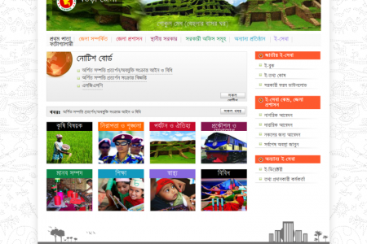
National Portal Framework

Slide 6
a. Administrative Reforms and Governance (cont.)
Measures towards Prevention of Corruption
National Integrity Strategy (10 State and 6 Non-state Institutions)
National Integrity Advisory Council headed by Hon’ble PM
Executive Committee of Advisory Council headed by Finance Minister
National Integrity Implementation Unit at Cabinet Division
Ethics Committee at every Ministry/Division and Institutions
Mobile Courts for Curbing Petty Offences
Separate law covering more than 100 minor Acts
Offences tried summarily on the spot
Electronic mobile court system under piloting

Slide 7
a. Administrative Reforms and Governance (cont.)
Grievance Redress System
Public hearing institutionalized
Actions taken immediately
Online GRS system developed
Promoting Innovation
Innovation in governance (GIU)
Innovation teams at central and field administration
Chief Innovation Officer
Service Innovation Fund

Slide 8
b. Capacity Building
National Skills Development Policy
National Skills Development Council (NSDC)
Prime Minister in the chair
Executive Committee (ECNSDC)
Co-chaired by Secretary M/o Education and private sector representative

Slide 9
b. Capacity Building (cont.)
Technical Training of Workers
Bureau of Manpower, Employment and Training (BMET)
70 Technical Training Centres (TTC)
Six TTCs exclusively for female migrant workers
Skills Development in Education Sector
BTV telecasts classroom lectures
Teachers’ portal

Slide 10
c. Improvement in Service Delivery
Deployment of ICT in Public Service Delivery
Transformation of 8,500 Post Offices to Post e-Centres
m-education, m-health, m-agriculture, m-commerce, m-banking etc.
30 lacs examinees of HSC and HSC received result through SMS in 2014
E-health Services
12 thousand laptops and 10thousand tablet computers with internet connectivity distributed
Telemedicine services at 43 hospitals and 30 UDCs
free health-related advice from doctors by mobile phone

Slide 11
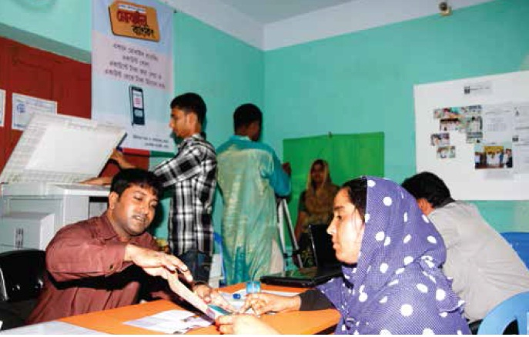
Digital Centre

Slide 12
c. Improvement in Service Delivery (cont.)
Improving Services on Education
32 crore copies of textbooks distributed
Introduction of e-book
Teaching and learning materials available on NCTB website
School Feeding Program and stipends
multimedia class-room with laptop, speakers and modem at 20,500 educational institutions
School Level Improvement Plan (SLIP) and Upazila Primary Education Development Plan (UPEP)

Slide 13
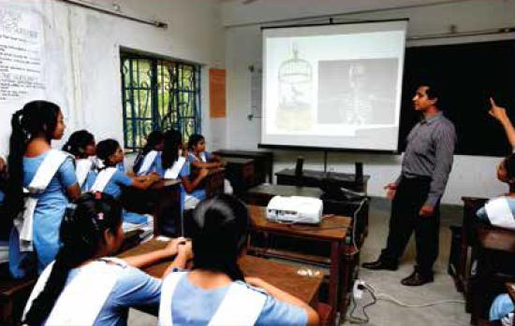
Multimedia Class Room

Slide 14
c. Improvement in Service Delivery (cont.)
One-stop service centres by some Ministries/Divisions an agencies
Probashi Kalyan Bank (Expatriates’ Welfare Bank)
Agriculture Call Centre
Disseminate latest technology
Toll-free hotline calling facility
Improving Judicial Services Management System
Cause lists and judgments in the website
Legal aid

Slide 15
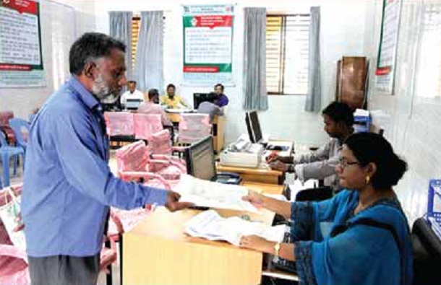
One-stop Services

Slide 16
d. Performance Evaluation and Management
Performance-based Evaluation System
Medium Term Budget Framework
Ministries formulate medium-term strategic objectives
Provide performance indicators
Annual Performance Agreement (APA)
Cabinet Division and 48 Ministries/Division
Mandatory Strategic Objectives on governance issues (RTI, GRS, NIS, Innovation etc.)
National Committee headed by Cabinet Secretary
Technical Committee headed by Secretary (C&R)

Slide 17
Thank you

